Slide 1
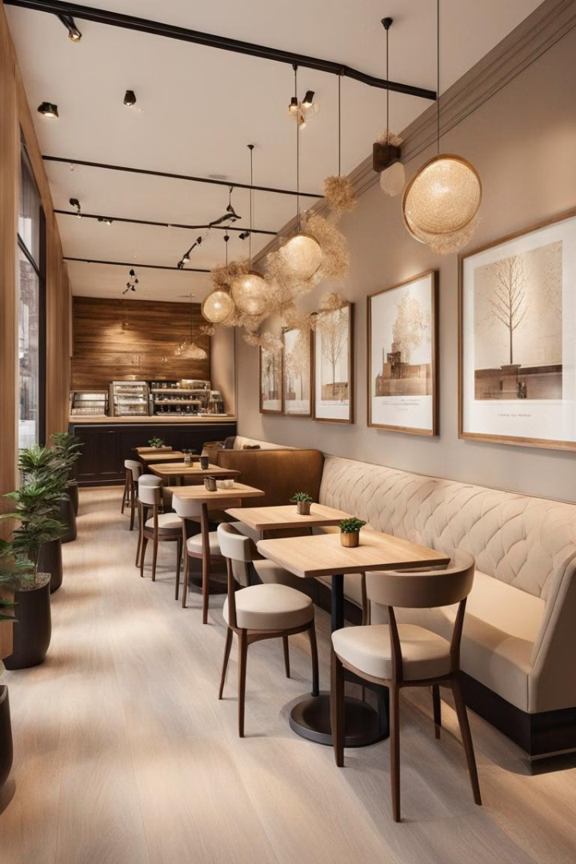


Coffee Shop Website
Welcome to our charming coffee shop website! Discover the perfect blend of great coffee and a warm atmosphere that will make you feel relaxed. Explore our menu, learn about our story, and get ready to enjoy every sip of it.
Prepared By: Mendha Foram Alpeshbhai
Roll No: 23 Enrollment No: 22002171210076
Batch: B1
Branch: CSE

Slide 2
HTML Structure and Layout
Semantic HTML
Responsive Design
Clean User Experience
Our website uses a well-structured, semantic HTML foundation to ensure accessibility and optimal search engine visibility.
The layout is designed to be fully responsive, adapting seamlessly to various devices and screen sizes.
The intuitive navigation and easy-to-find information create a smooth, enjoyable user experience for our customers.

Slide 3
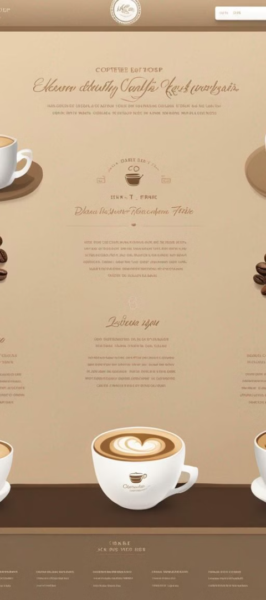
CSS Styling and Design
1
Cohesive Branding
2
Captivating Aesthetics
Our custom CSS styles reflect the coffee shop's unique branding, with a warm, inviting color palette and consistent visual elements.
Our CSS styling creates a visually striking and harmonious design, reflecting the refined elegance of the coffee shop experience.
3
Accessibility
Our CSS ensures the website is accessible to all users, prioritizing inclusivity and providing a positive experience for everyone.

Slide 4
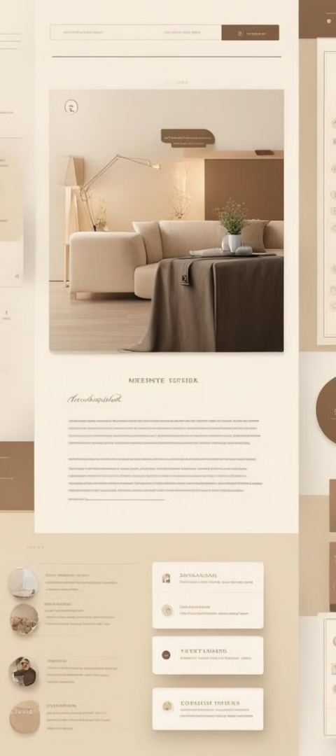
JavaScript Interactivity
1
Dynamic Content
JavaScript powers the coffee shop's menu, allowing customers to easily filter and sort items.
2
Interactive Features
Smooth animations and responsive user interactions enhance the overall browsing experience.
3
Personalized Experience
Custom JavaScript scripts provide a tailored experience, such as saved order preferences and personalized recommendations.

Slide 5
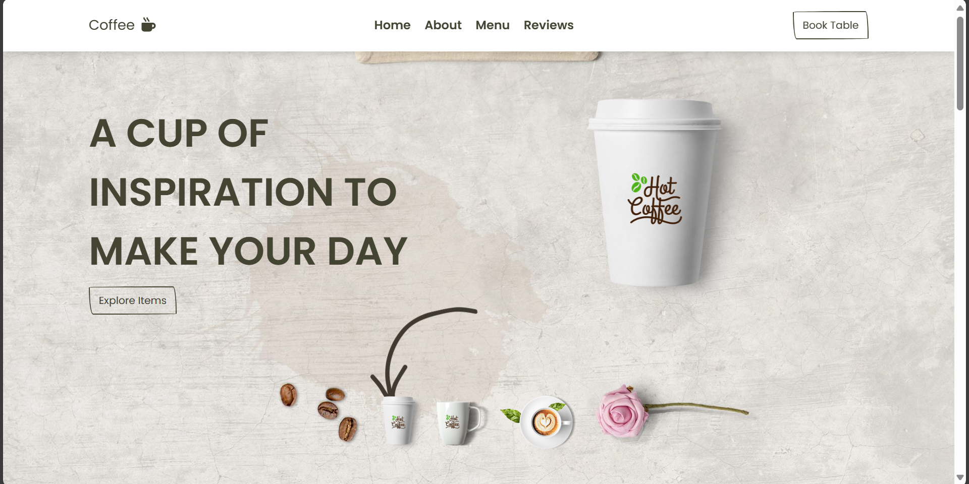
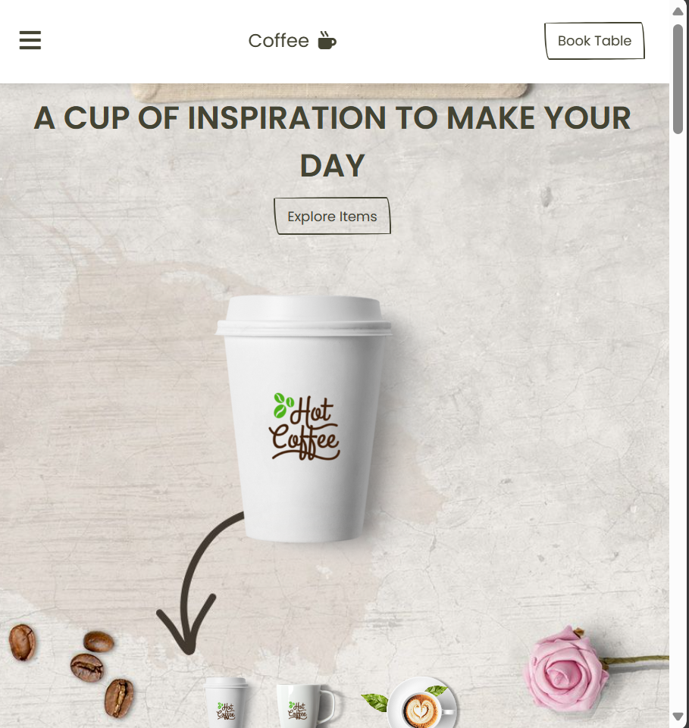
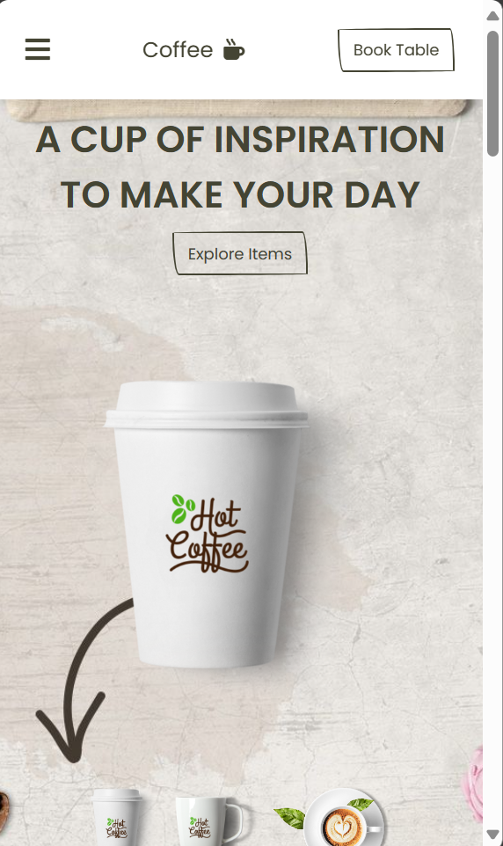
Common Responsive Breakpoints
When size is 1024px
Laptop
When size is 768px
Tablet
When size is 480px
Phone

Slide 6
Thank You
We appreciate your time and consideration

